Slide 1
scRNAseq ANTXR1 analysis
Data: GSE250396
Presented to Darren: 24 Feb 2025

Slide 2
Dataset Site: https://www.ncbi.nlm.nih.gov/geo/query/acc.cgi?acc=GSE250396
Summary:
Fibrosis, the replacement of healthy tissue with collagen-rich matrix, can occur following injury in almost every organ. Mouse lungs follow stereotyped sequences of fibrogenesis-to-resolution after bleomycin injury, and we reasoned that profiling post-injury histological progression could uncover pro- vs. anti-fibrotic features with functional value for human fibrosis. We mapped spatiotemporally-resolved transformations in lung extracellular matrix (ECM) architecture to spatially-resolved, multi-omic data. First, we charted stepwise trajectories of matrix aberration vs. resolution using unsupervised machine learning, denoting a reversible transition in uniform-to-disordered histological architecture. Single-cell sequencing along these trajectories identified temporally-enriched “ECM-secreting” (Csmd1+) and “pro-resolving” (Cd248+) fibroblasts, for which Visium inferred divergent histological signatures and spatial-transcriptional “neighborhoods”. Critically, pro-resolving fibroblast instillation helped ameliorate fibrosis in vivo. Further, fibroblast neighborhood-associated moieties, Serpine2 and Pi16, functionally modulated human lung fibrosis ex vivo. Spatial phenotyping of idiopathic pulmonary fibrosis further uncovered analogous fibroblast subtypes and neighborhoods in human disease. Collectively, these findings establish an atlas of pro-/anti-fibrotic factors underlying lung matrix architecture and implicate fibroblast-centered moieties in modulating fibrotic progression vs. resolution.

Slide 3
Dataset Description
Timepoints: Control, Day 14 post injury, Day 35 post injury
Tissue: Whole lung (unsorted)
Mouse strain: C57BL/6

Slide 4
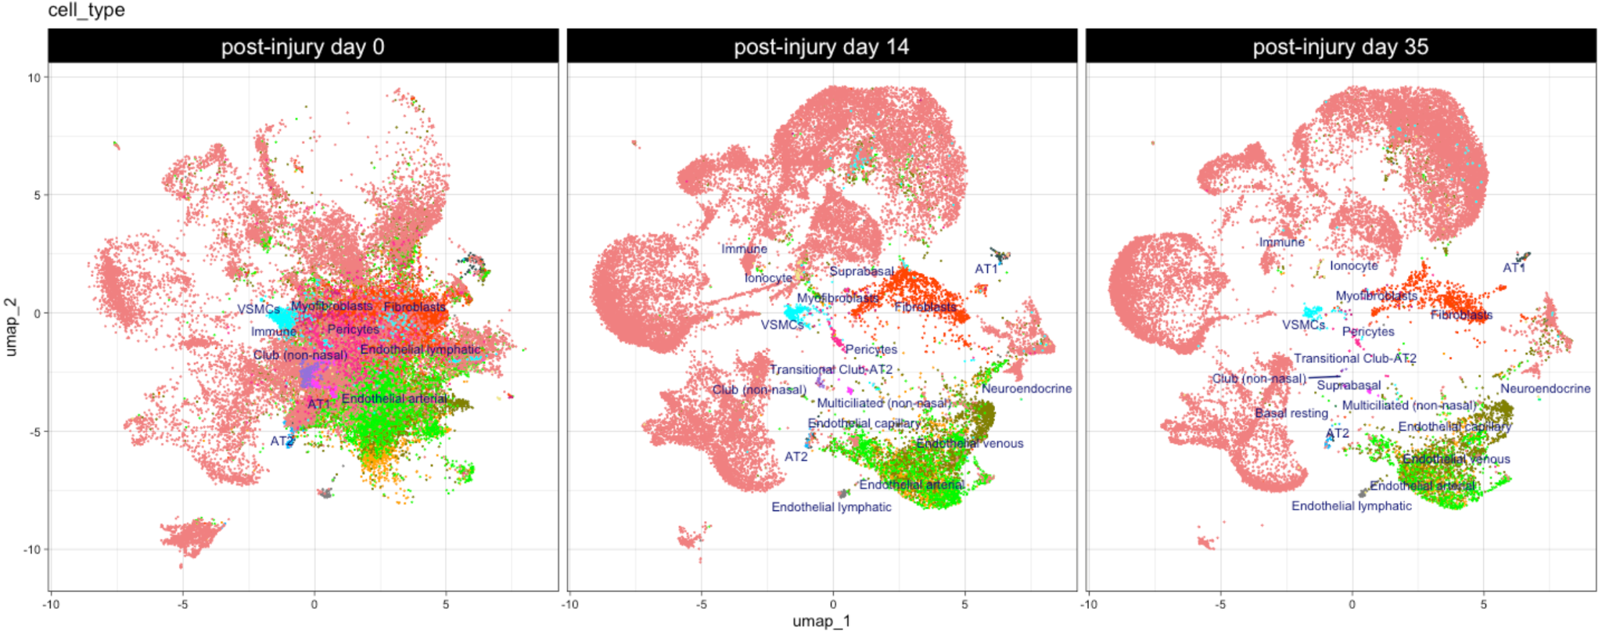
Global cell proportion changes across control, day 14 post BLM, day 35 post BLM

Slide 5
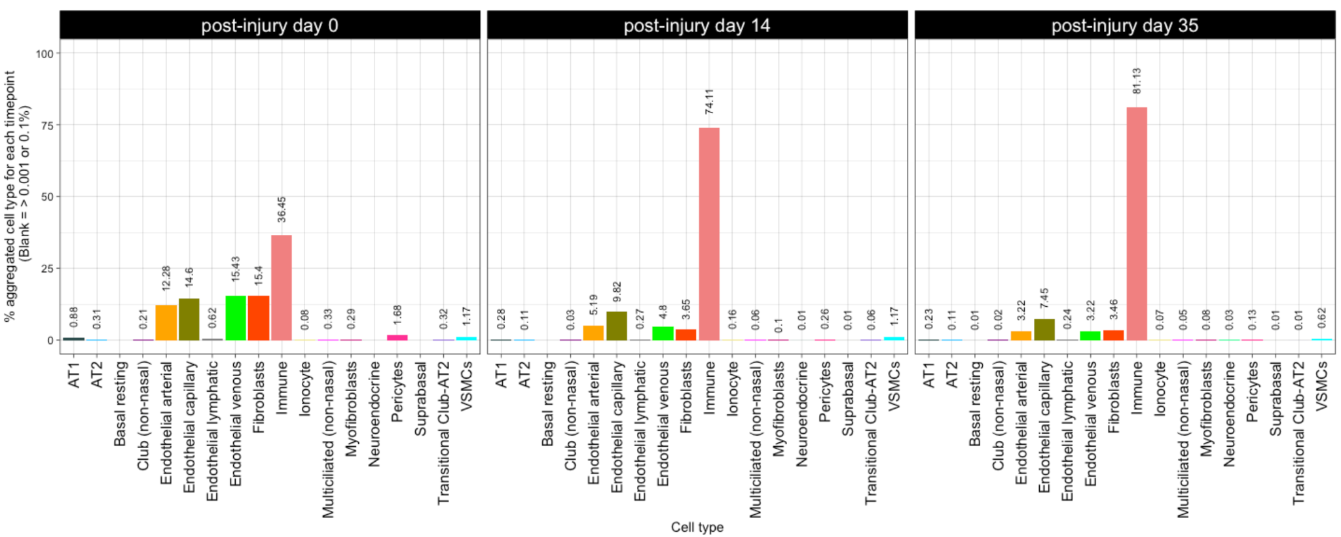
Global cell proportion changes across control, day 14 post BLM, day 35 post BLM

Slide 6
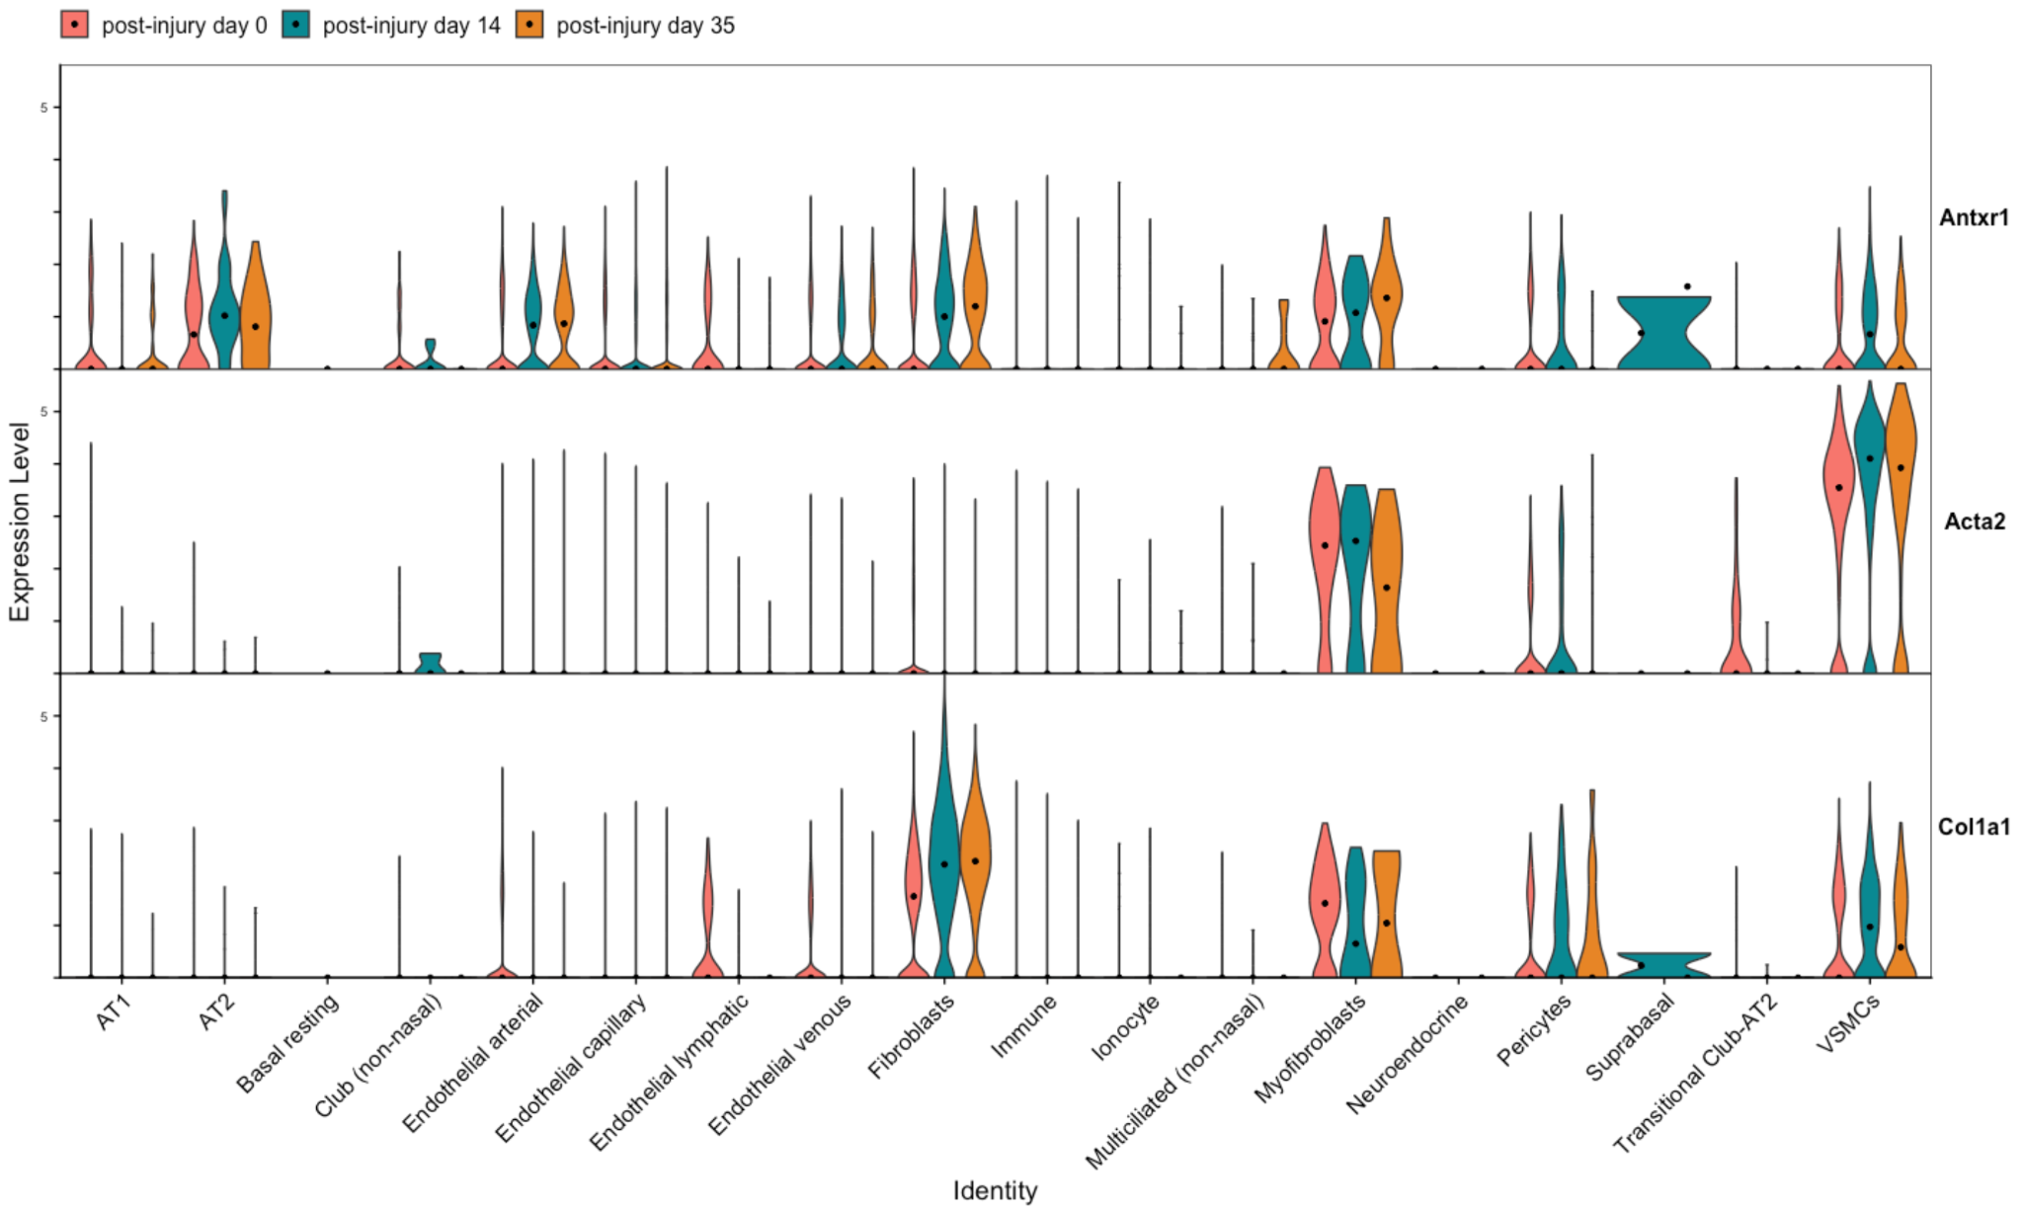
Expression levels of ANTXR1 and different genes of interest across all cell types. (Dot = Median expression)

Slide 7
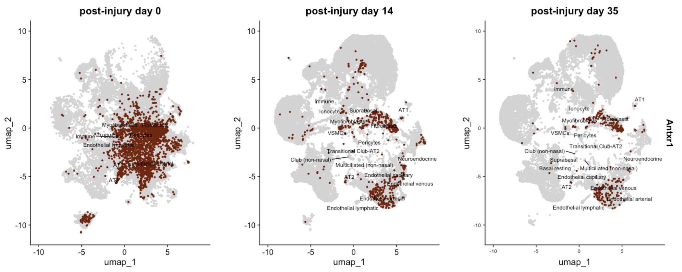
Global reduction in ANTXR1 expression correlated to loss of cells across timepoint

Slide 8
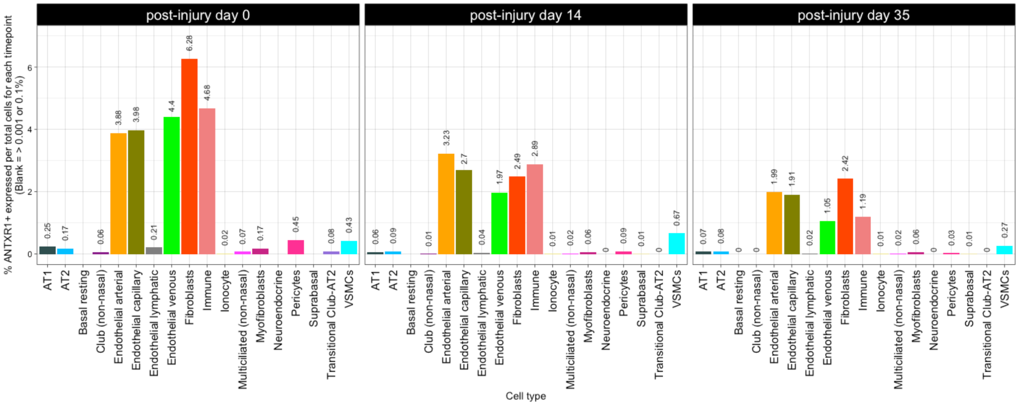
Quantifying ANTXR1+ changes as a percentage of total cells at each timepoint.

Slide 9
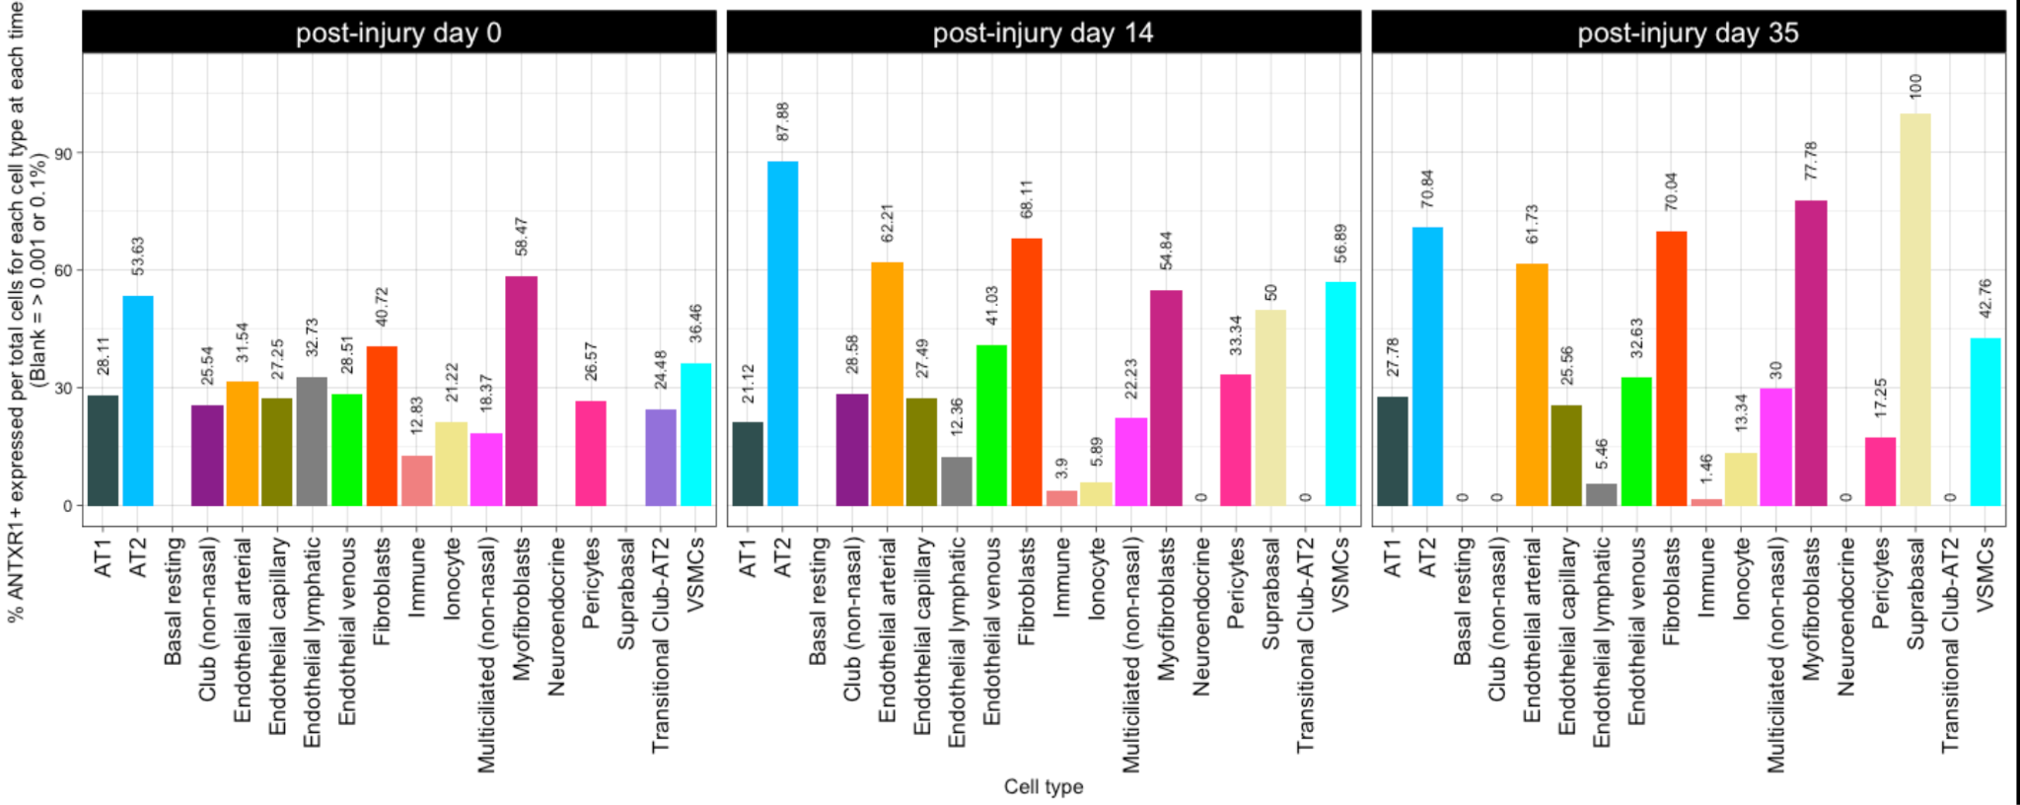
Quantifying ANTXR1+ changes as a percentage of total cells of the cell type at each timepoint (thus controlling for the changes to the total cells at each time point as a result of injury).

Slide 10
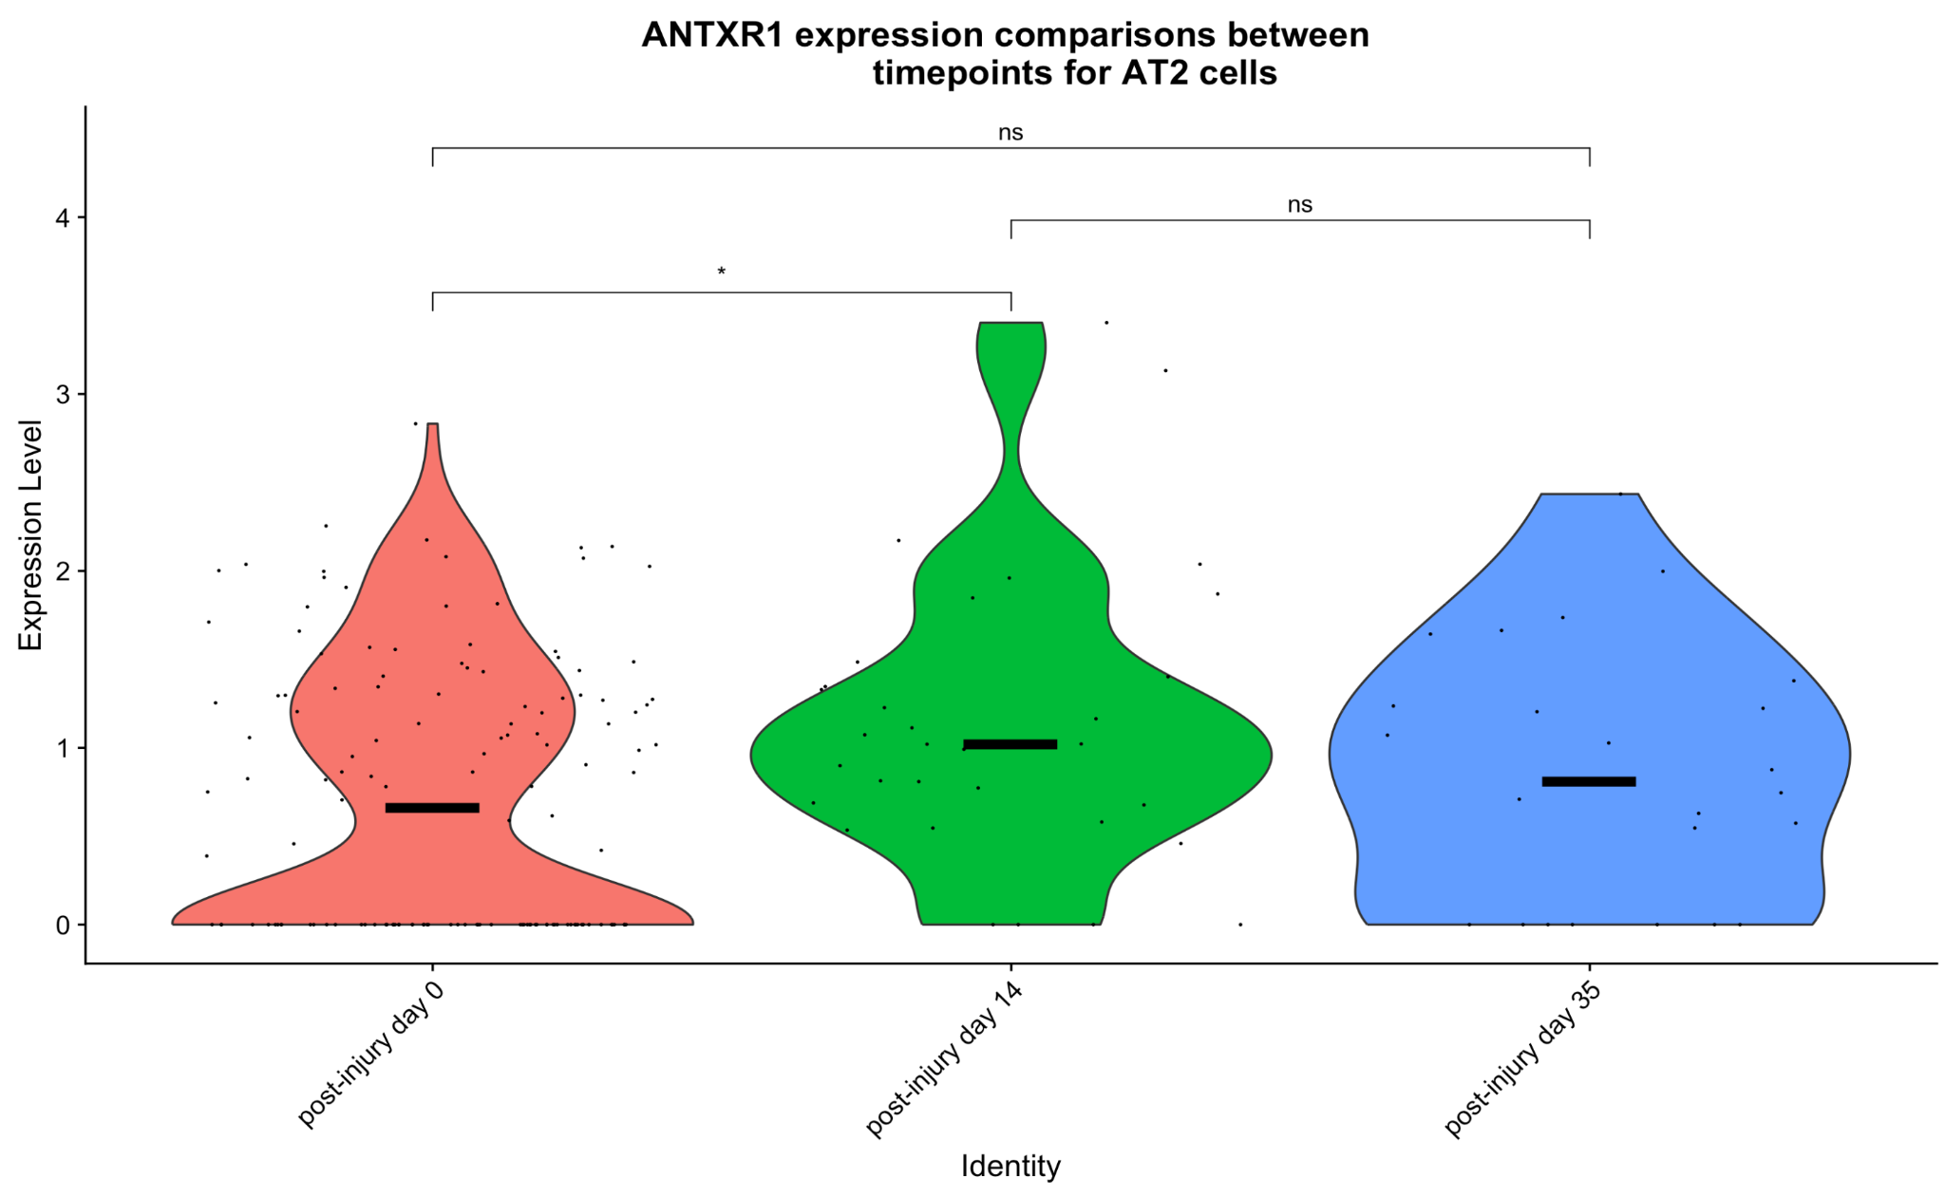
Zooming in on ANTXR1 expression comparison between specific cell types at different timepoints.
ANTXR1+ AT2 cells at different timepoints. Line shows median expression. Stat: T-test

Slide 11
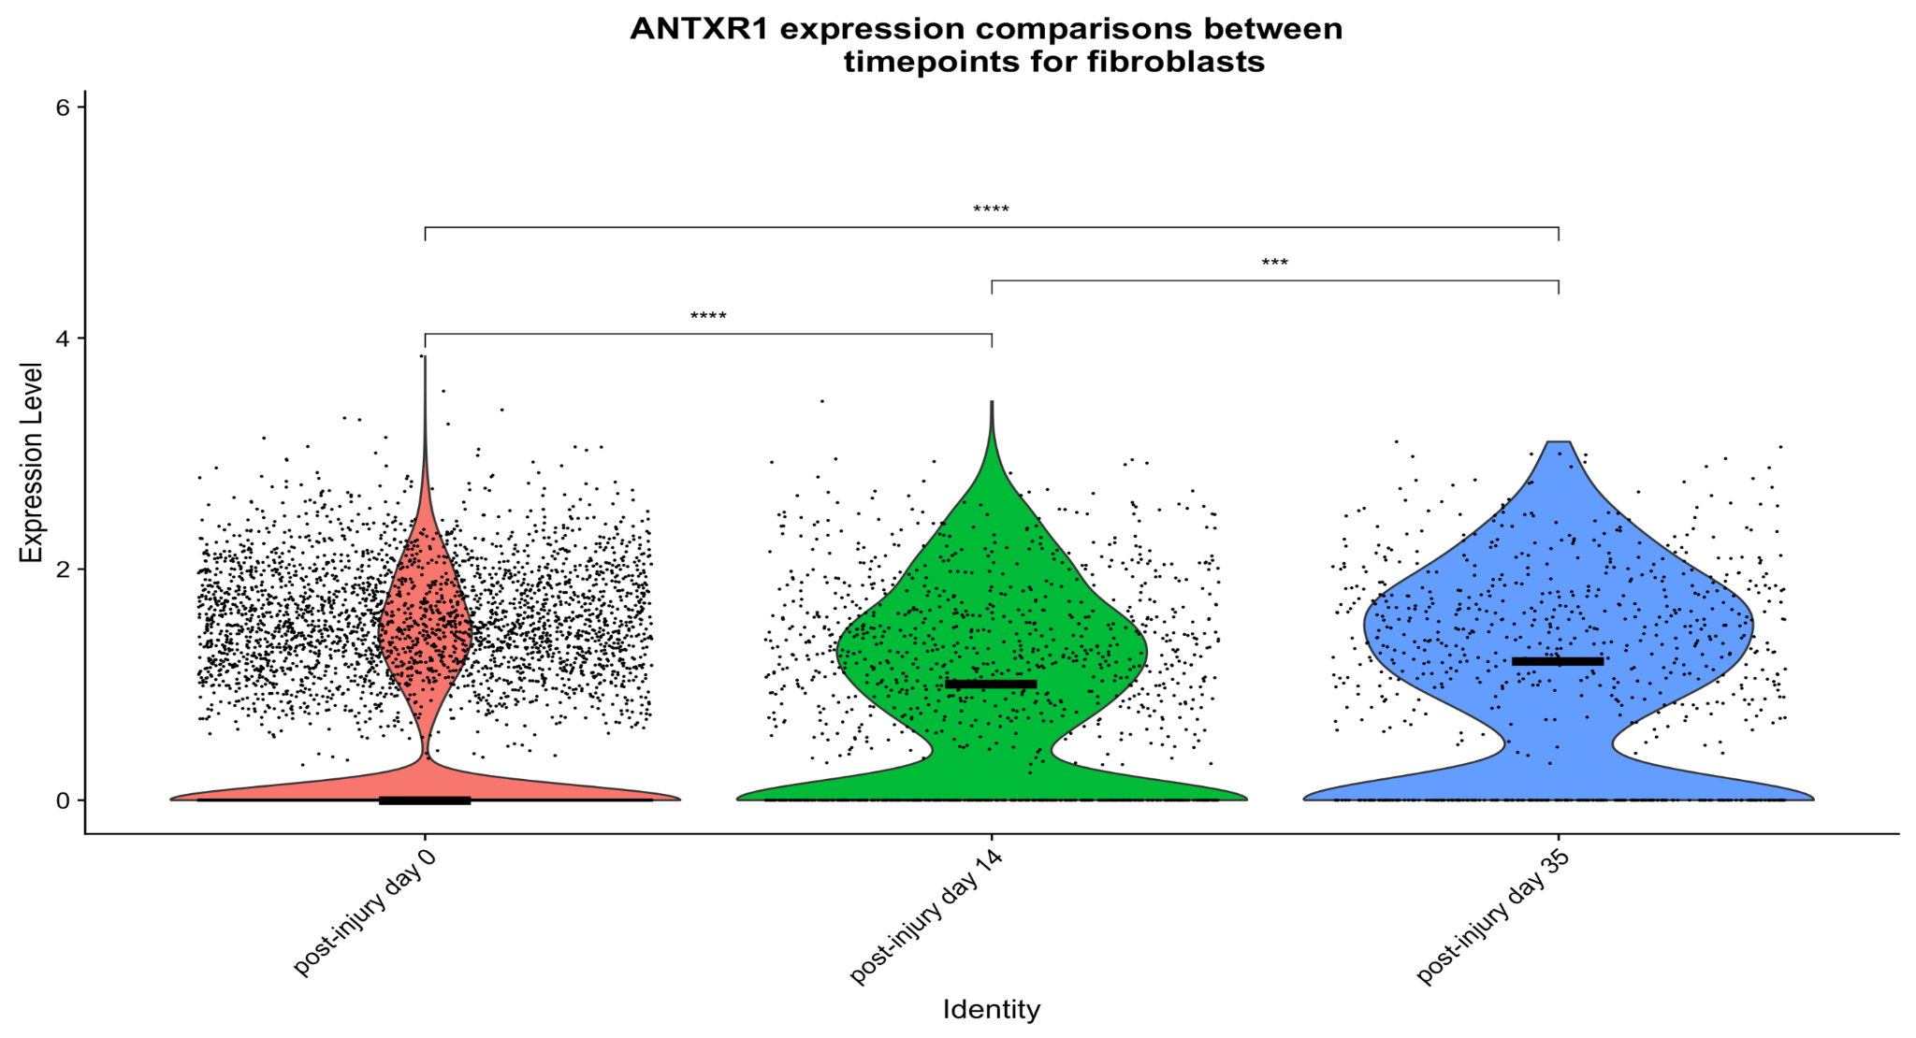
Zooming in on ANTXR1 expression comparison between specific cell types at different timepoints:
ANTXR1+ fibroblasts & myofibroblasts at different timepoints.
Line shows median expression. Stat: T-test

Slide 12
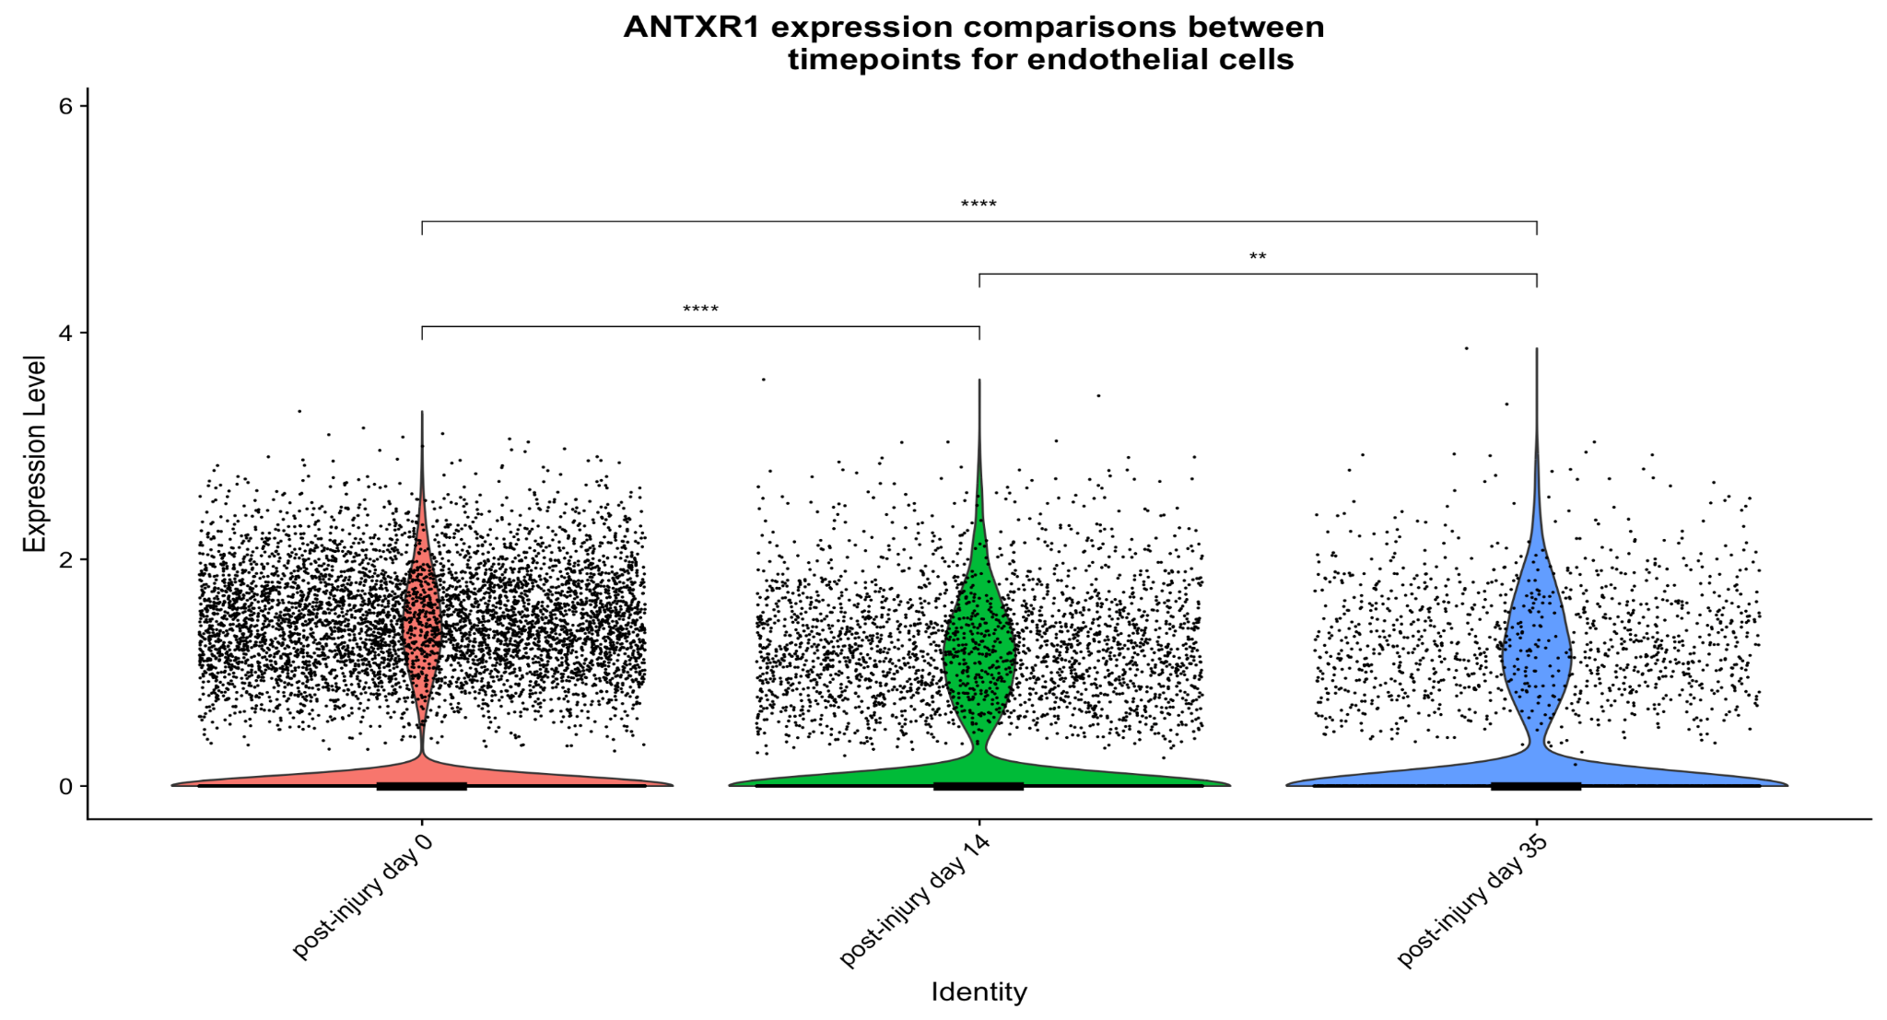
Zooming in on ANTXR1 expression comparison between specific cell types at different timepoints:
ANTXR1+ endothelial cells at different timepoints. Line shows median expression. Stat: T-test

